Slide 1
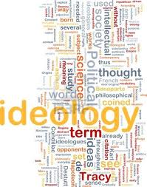

Rethinking Theory in Black Studies
Abdul Alkalimat
Department of African American Studies
University of Illinois
Fall 2011

Slide 2
The Lecture Series
Rethinking Theory in Black Studies
45 years after Black Power posed a challenge to thinking by
and about the African American experience it is necessary to
rethink this legacy of changing consciousness. This is both a
look at the theoretical formulations in the academic field of
Black Studies, but more importantly it is thinking about how
we the people can understand and be more self determining
about our consciousness and how we can reorient ourselves
to the fight for freedom. Now as then, we have work to do.
Towards this end we have planned five public lectures as part
of our Fall 2011 course, Theory in Black Studies:
September 13 Ideology
September 27 Methodology
October 11 History
October 25 Tradition
November 8 Debate

Slide 3



Historical development of Black Studies
Black Studies as social movement
Black liberation movement targets
higher education and creates new
intellectual space for creative
work to serve the needs of the people
Black Studies as academic profession
Black Studies conforms to campus
culture and administrative practices
and becomes estranged from the
community
Black Studies as knowledge network
With digital technology, Black Studies
begins to reunite with the community
via cyberspace and become a major
global discourse

Slide 4
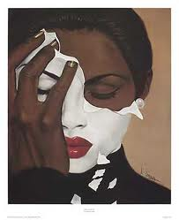

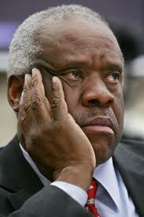
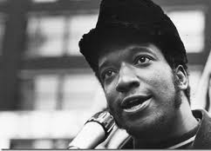

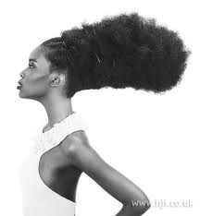
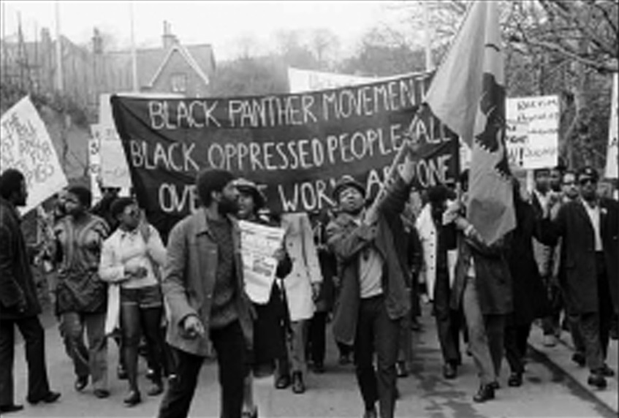
Lecture #1: IDEOLOGY
The ideological crisis we face
The ideology we need

Slide 5
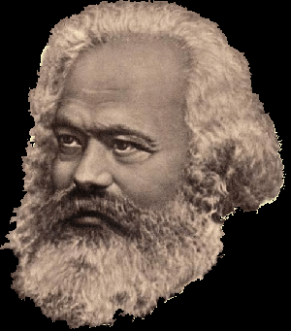
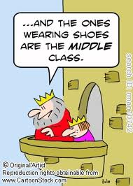
In the social production of their existence, men inevitably enter into definite relations, which are independent of their will, namely relations of production appropriate to a given stage in the development of their material forces of production. The totality of these relations of production constitutes the economic structure of society, the real foundation, on which arises a legal and political superstructure and to which correspond definite forms of social consciousness. The mode of production of material life conditions the general process of social, political and intellectual life. It is not the consciousness of men that determines their existence, but their social existence that determines their consciousness. At a certain stage of development, the material productive forces of society come into conflict with the existing relations of production or – this merely expresses the same thing in legal terms – with the property relations within the framework of which they have operated hitherto. From forms of development of the productive forces these relations turn into their fetters. Then begins an era of social revolution. The changes in the economic foundation lead sooner or later to the transformation of the whole immense superstructure.
Karl Marx (1818-1883)

Slide 6
What is ideology? Why do we start here?
A theory is an abstract description and explanation of what is. However, we never engage in this kind of thinking without a context, especially when dealing with social theory, theory about society.
Our theory is always formulated in a dialectical time dimension:
Past……….Present……….Future
In the present we imagine a desired future and for that we reconstruct our understanding of the past.
The “what is” focuses on theory, the “what ought to be” focuses on ideology, and that includes theory.
For the African American experience there is no more important focus than on what ought to be! The ideological struggles over the past are significant because they are alternatively tied to different visions of what future “ought to be.”

Slide 7
Decoding the polarity of ideological conflict
Past
Present
Future
We created the wealth and
development of society as
the prime movers of history.
The ruling class
The corporate rich and
all other major racists
and exploiters
We want to rule forever!
(Is there a middle ground or do people have to choose sides?)
We have been cheated out
of the wealth of our labor
and we have to fight the
rulers to get justice and
end poverty.
The oppressed
African Americans and
all other oppressed and
exploited people
We want freedom
and a decent life!

Slide 8
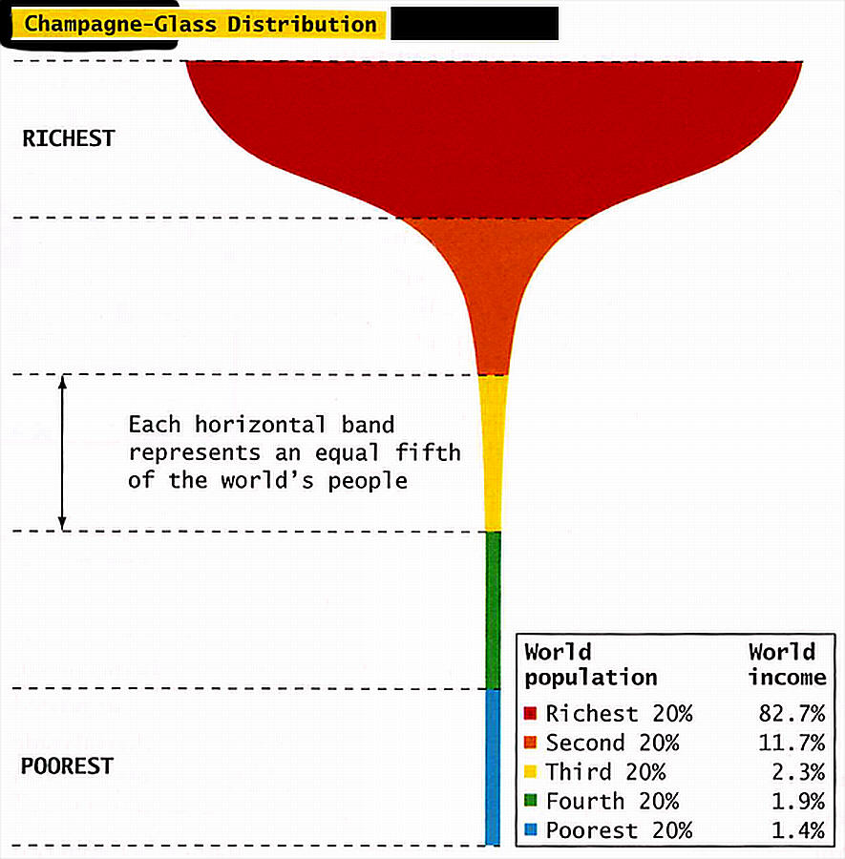
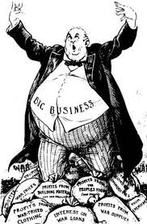
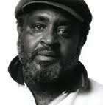

Great macro-ideological struggle of the 20th century
Capitalism
Socialism
The champagne-glass distribution of income.

Slide 9
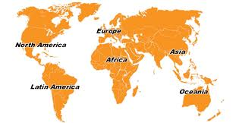
Polarities of 20th
century struggle
Communist parties lead the fight of
workers to seize power from the
capitalists and create the socialist camp.
In the end the USSR was the critical
leader, including the fight against fascist
Germany, a capitalist power gone berserk.
Capitalist countries
fight each other to
divide and re-divide
the world for their
plunder through
WWI and WWII.
In the end the US
rises as the leading
capitalist power in
the world, operating
through global institutions
like the UN, IMF and World
Bank.
Popular forces in the colonized
countries of Asia, Africa and Latin
American create national liberation
movements to fight to end the
domination of western colonialism
and imperialism.

Slide 10
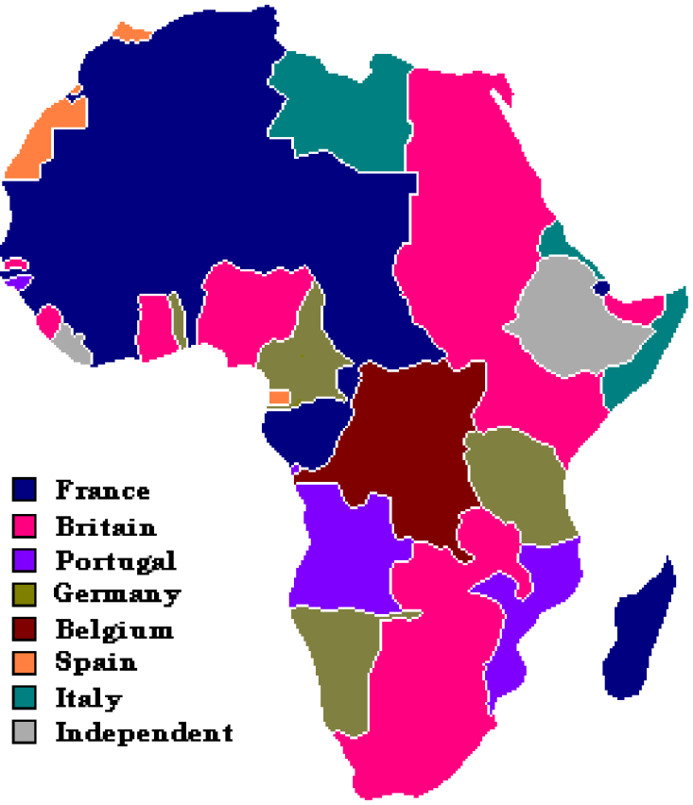
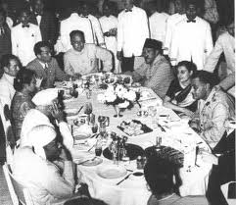
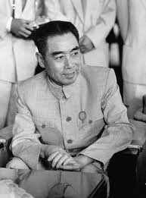
Third world fight against colonialism and imperialism
Colonialism/imperialism:
European/western powers
Decadent feudalists
Comprador capitalists
Mercenary war lords
Example: The 1885 Berlin
Conference when they carved
Up Africa for European interests.
National Liberation Movement:
Workers
Peasants
Middle class
National capitalists
Patriotic feudal leaders
Example: The 1955 Bandung Conference

Slide 11
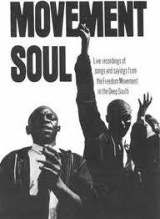
Our freedom struggle was turned into a civil rights struggle
1789 US Constitution goes into effect. Written by slave owners. Failed to end slavery or even the slave trade. Established “civil rights.” But the Bill of Rights was not included and had to be added after the threat of armed struggle by the workers and farmers.
1865 The thirteenth amendment to the Constitution ended slavery. 1963 Abe Lincoln had issued the “Emancipation Proclamation” to free the slaves where he couldn’t but not where he could.
1964 The Civil Rights Act defines the accomplishment of the “Freedom Movement” that had been turned into a “civil rights movement.” Fighting to be free from the system became being in that system! Freedom became a piece of paper.

Slide 12
Social Class
Crisis of National liberation/Socialism = crisis of Black Power
National liberation movement was led by
middle classes who in the end betrayed the
revolutionary process by being captured by
neo-liberal policies of late capitalism. The
exception was China and the leadership of
the Communist Party and Mao’s theory of
New Democracy.
Socialism of the 20th century is turning to
embrace various forms of capitalism in the
21st century. Class polarity and poverty have
forced socialism into crisis.
Black Middle Class in the US now includes a
mainstreamed fraction that has joined with
corporate interests in opposition to the African
American majority.
Examples of betrayal:
Zimbabwe
South Africa
Examples of restoring capitalism:
Russia
China
Examples of betrayal:
Corporate officials
High government officials
Elite academics

Slide 13
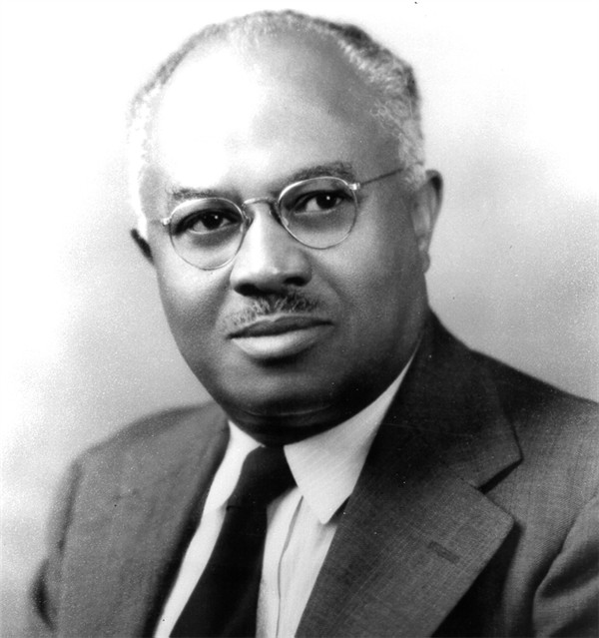
E Franklin Frazier sounded the ideological alarm
“All African intellectuals begin with the fact of the
colonial experience of the African. They possess a
profound understanding of the colonial experience
and its obvious effects upon not only their traditional
social organization, but of the less obvious and more
profound effects upon the culture of the African
personality.
The American Negro intellectual goes his merry way
discussing such matters as the superficial aspects of
the material standard of living among Negroes and
the extent to which they enjoy civil rights. He never
begins with the fundamental fact of what slavery has
done to the Negro or the group which is called Negroes
in the United States.”
“The failure of the Negro Intellectual”
Negro Digest (February, 1962, pages 26 – 36)
1894 – 1962
Professor, Howard University

Slide 14
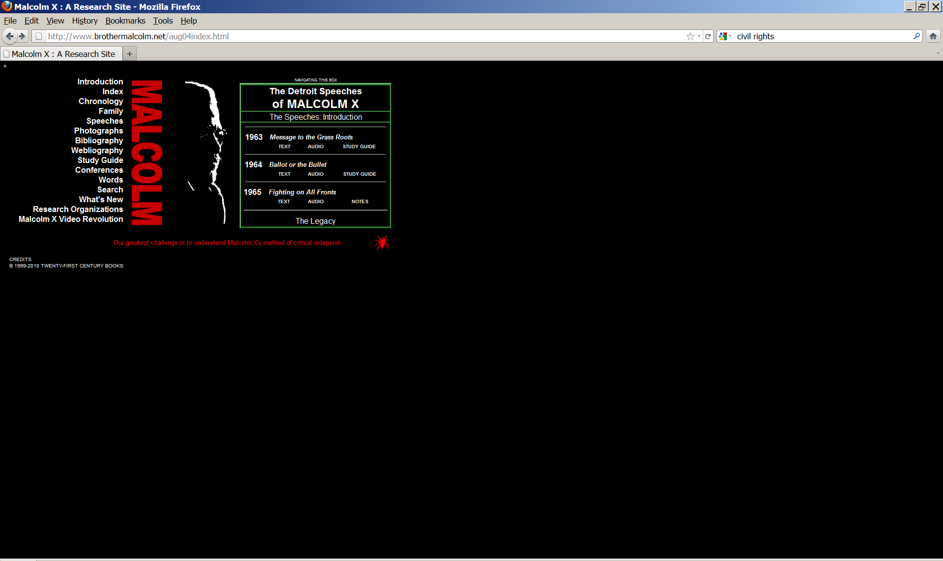
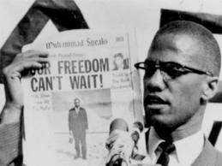
Malcolm X
(1925 – 1965)
A revolution in Black ideology and political culture took place when Black people broke free from the integrationist movement to return to the demand for freedom. The main ideological spokesperson for this movement was Malcolm X. He was also undergoing ideological transformation toward the three speeches in Detroit that laid out in great rhetorical style the outlines of the ideology of Revolution from a Black perspective. Malcolm X was our revolutionary icon.

Slide 15

The Malcolm X Moment = systemic qualitative change
Black Power = community organizations fighting
for elected officials, redistribution of
budgets, representation on policy making
bodies. Black people need to rely on themselves.
Black Arts Movement = redefined aesthetics and
standards of beauty creating an
autonomous space for Black creativity. Black
People are beautiful and profoundly human.
African Liberation Support = reuniting the Black
liberation movement of the African Americans
with the fight for national liberation in Africa.
All of African must be free!
Black Studies = greatest anti-racist innovation in higher
education, greatest increase in development
of a Black intelligentsia with a liberation consciousness.
We are our own source of knowledge.
Malcolm

Slide 16
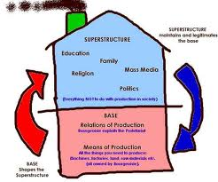
There is a technological revolution!
Digital technology, including computers,
the Internet, genetic engineering, etc.,
has transformed the means of production.
This technology has permanently excluded
masses of workers from ever again having
full time employment. This creates a new
class of people with no social contract for
their survival.
This technology has allowed the capitalists
to delink from a specific country and
become global capitalists more than ever
before.
If there is a revolution in the base,
how will a revolution take place in the superstructure?

Slide 17
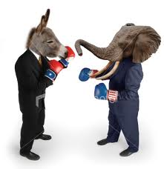
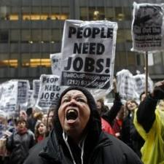
The new developments are new classes!
New classes means new revolutionary possibilities
Where
Is the
Party
Of the
New Class
Of
Impoverished
workers?
The dialectical opposite of the new global corporate and government elite
is the impoverished sector being thrown out of society with no social contract
and near permanent unemployment. The global capitalists are amassing great
fortunes while the masses of people are being forced into new levels of poverty.

Slide 18
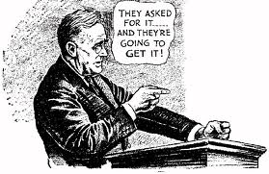
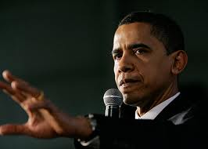
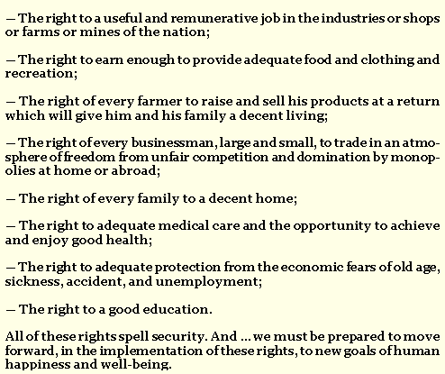
Many thought that Obama could be another FDR
& transform the Democrat Party for us. Did he?
1944
2011
A plan he
proposed but
couldn’t get:
A plan against
the people that
he got!:
Bail out for the big banks he considered
too big to fail. Black youth unemployment
nearly 50% in many cities!
Preparing to cut Medicare and Medicaid.
Cut home heating subsidy for the elderly.
Fails to meet with and support the policies
of the Congressional Black Caucus.
Continues to lead the US into unnecessary
wars, the latest being Libya.

Slide 19
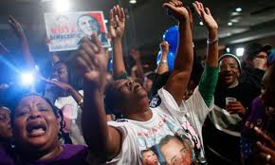
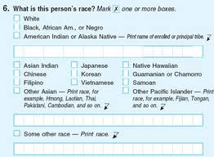
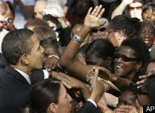
The Obama Moment was thought to be
a political opportunity, but now we know
it as an ideological defeat! More than him.
A section of the middle class embraces
multi-racialism while the masses remain
Black! Example is Tiger Woods &
Cablinasian and US Census changes.

Slide 20
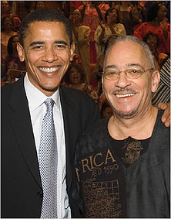
Obama rejects the Freedom movement
for compromise with American mainstream
Is the American glass half full, or half empty?
“This is the reality in which Reverend Wright and other African-Americans of his generation grew up. They came of age in the late fifties and early sixties, a time when segregation was still the law of the land and opportunity was systematically constricted. What's remarkable is not how many failed in the face of discrimination, but rather how many men and women overcame the odds; how many were able to make a way out of no way for those like me who would come after them.”—Obama, March 18, 2008
“When it came to putting the citizens of African descent fairly, America failed. She put them
in chains. The government put them on slave quarters. Put them on auction blocks. Put them
in cotton fields. Put them in inferior schools. Put them in substandard housing. Put them in
scientific experiments. Put them in the lower paying jobs. Put them outside the equal
protection of the law. Kept them out of their racist bastions of higher education, and locked
them into positions of hopelessness and helplessness.
“The government gives them the drugs, builds bigger prisons, passes a three strike law and
then wants us to sing God Bless America. Naw, naw, naw. Not God Bless America. God
Damn America! That’s in the Bible. For killing innocent people. God Damn America for
treating us citizens as less than human. God Damn America as long as she tries to act like
she is God and she is Supreme.”—Rev. Wright, April 13, 2003

Slide 21
The crisis we face is 1963 vs 2008:
The Malcolm X Moment vs the Obama Moment
Malcolm X argued that Black people must unite and fight against a common enemy, the system of racism and class exploitation, on a world scale “western interests.”
Obama argues that Black people must unite with all Americans and fight for political reforms based on policies that Republicans and Democrats can agree on.
    Malcolm argued that we have to begin with an analysis of revolution on a global
    scale based on land and bloodshed.
    Obama argues that we begin within the policy framework of the US and that we
    proceed based on the policy recommendation of the military generals.
        Malcolm argued the position of the field Negroes and spent his time with them.
        Obama argues the position of the mortgage bankers and pulls them close to him as advisors.
This is the ideological crisis we face. What is the future we want? What has been our past?

Slide 22
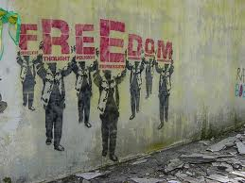
The solution is in our hands –
We must become difference makers
There are several critical questions
to be answered to resolve this
ideological crisis, questions that require
us to become masters of our ideological
orientation.
Do we believe freedom is possible,
no matter the odds?
Do we believe Black people can
once again build a freedom movement?
Do we believe that America will be good for Black people without a freedom movement, the mainstream will do what is right?
Do we believe in “academic excellence and social responsibility”?

Slide 23
We need an ideological framework
(a tool for mapping others and personal transformation)
Identity: Who are we? Who am I? Why is this important?
Analysis: What are the problems we face? That I face? And what are the solutions that are possible?
Commitment: How important is the solution to me? To us?
Program: What plans do I (we) have to get to the solution? Who are my (our) friends? Enemies?
Action: What are the concrete steps to be taken now?

Slide 24
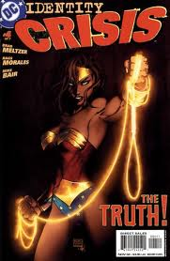
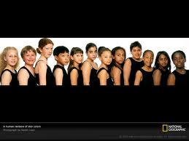
Identity:
Who are Black people?
How do we know?
Who do they think they are?
What do others think?
What difference does it make?
These are fundamental aspects
of the ideology we need

Slide 25
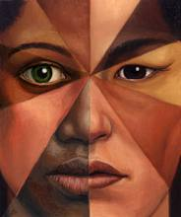



Five approaches to the identity of Black people
…as a social relation
…as a language, name
…as psychology, self concept (image)
…as culture
…as class
The dialectics of Black identity as a social relation
Black relations with whites (Europeans)
Black relations with other Blacks (Africans and the Diaspora)
Black relations in the US with each other
Blacks in global context

Slide 26

Three naming crises
What is the biological name?
Is this science or racist ideology?
Is this about phenotype or genotype?
What is the group name? Are Black people
a nationality? Negro? Or is there a land based reference for origin?
What is the individual naming practice? Were Black people named after slave masters? How do we name ourselves today?

Slide 27
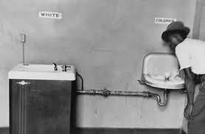
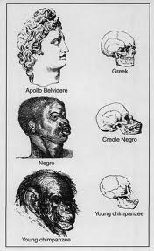
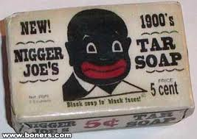
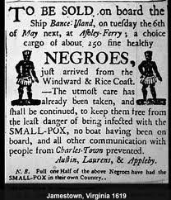
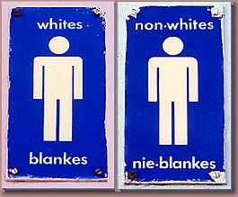
Group names are critical:
What have we been called?
Social relations with white people:
Colored
Nonwhite
Names of isolation:
Negro
Nigger

Slide 28
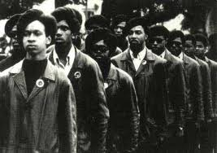
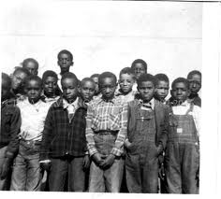
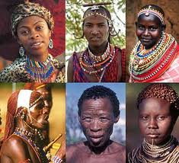
What have we called ourselves?
Traditional African nations
Black
African Americans
Afro-Americans

Slide 29
American Black Baby Names for Girls
American Black Baby Names for Girls have origins in many languages including French, Latin, English and African. Many black baby names for girls have the popular prefix of 'La' or 'Le' ( Latoya, Lashawn, Latrice etc) and also 'Da' and 'De' (Denelle, Danisha etc) Names like Tanisha (meaning the name of a day indicating birth on a Monday) originate in Africa from the Hausa language. Other African languages include Zulu, Swahili, Igbo and Yoruba.
Black Baby Names for Boys
Black Baby Names for Boys also have origins in many languages including French, Latin, English and the various languages which originated in Africa. Many Black Baby Names for Boys have have connections to Greek and Classical literature, the bible or reflect noble positions such as Earl, Prince or Duke. There are also those with the prefix of 'La' as is Lamarr or DaJon. There is also a trend to make unusual use of hyphens in Black Baby Names for Boys, capital letters and apostrophes such as D'marreio or D'Sean and Le-Vaughn.
The masses of Black people continue to assert
a Black identity in naming children!

Slide 30
Analysis:
Crisis of Metaphysical vs Dialectical Thinking
Time | Problem | Solution
Past | National oppression, Class Exploitation | Negotiate, escape, or fight
Present | National oppression, Class Exploitation | Negotiate, escape, or fight
Future | National oppression, Class Exploitation | Negotiate, escape, or fight

Slide 31
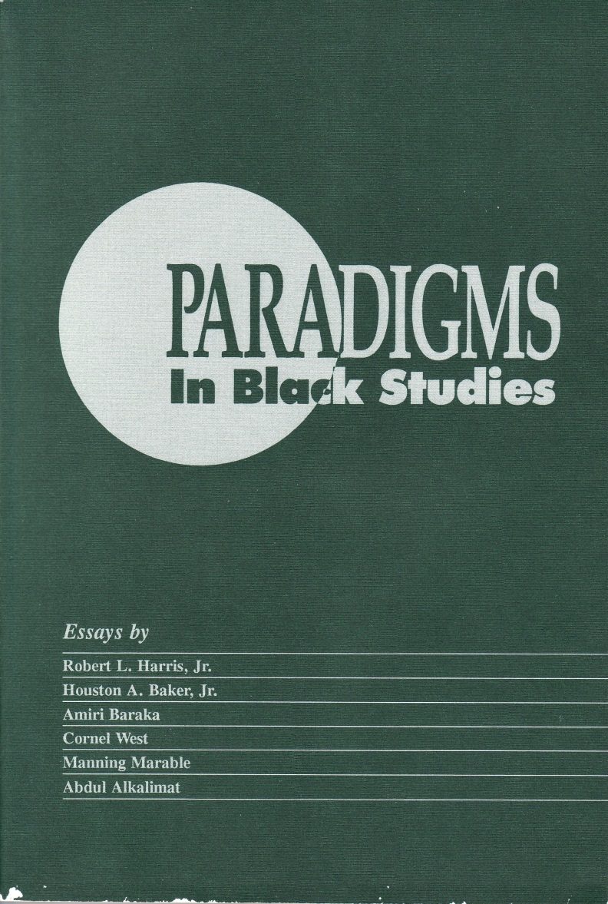
A new paradigm!
The Malcolm X moment changed all disciplines
The integrationist position
negated a Black perspective
because of the absolute need
to be universal. This was
reversed. The Black particularity
was defined as the fundamental
grounding for attaining the
universal. This was/is a return
to the source.

Slide 32
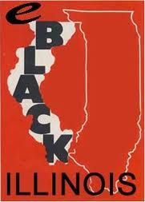


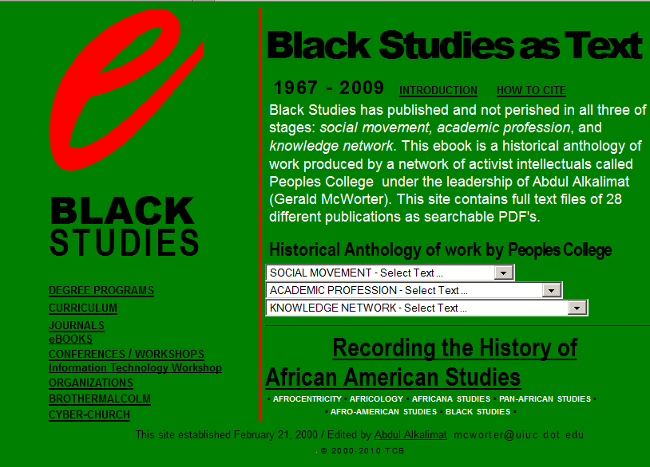
Ideological mission of Black Studies:
Academic excellence and social responsibility

Slide 33
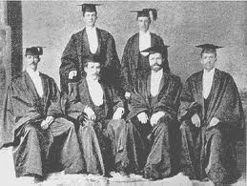
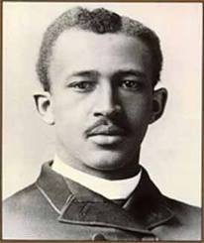
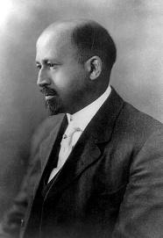
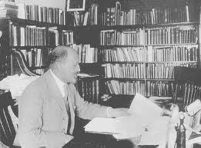
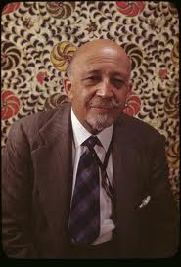
Excellence is defined by Black intellectual history.
Our analysis can build upon centuries of insight, especially the last
100 years of scholarship in the radical Black tradition.
W. E. B. DuBois
(1868 – 1963)

Slide 34
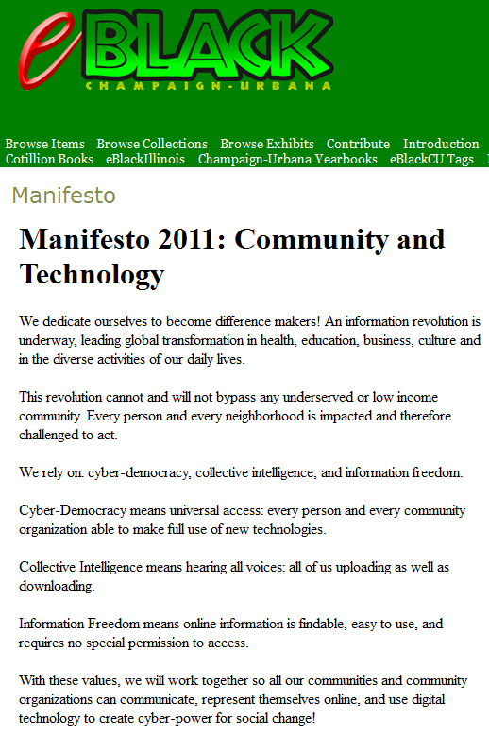

Social responsibility
means serving the
people.

Slide 35




Commitment:
A rhetorical passion, or material investment?
Words & intentions
vs
2 Time and money
Where does the money go?
How much time do you have: 24/7, right?
How much have you invested in a project?

Slide 36



Program: Plans to utilize all available resources,
along with uniting allies, to go up against the
enemies of the people
Strategy: long range plans for victory
Tactics: Short term plans that change with the
day to day circumstances within the
overall strategy

Slide 37

Leadership is about
being responsible to
the community –
so planning is the
essential task!
Go to the people. Learn from them. Live with them. Start with what they know. Build with what they have. The best of leaders when the job is done, when the task is accomplished, the people will say we have done it ourselves.—Lao Tzu

Slide 38


“Now is the time.”—Charlie Parker
“The enemy advances, we retreat;
the enemy camps, we harass;
the enemy tires, we attack;
the enemy retreats, we pursue”
—Mao Tse-tung
“There’s nothing to it but to do it.”
—E. Barry Gaither
Plan your work,
then work your plan!

Slide 39

Websites to check for more info
eBlack Studies
http://www.eblackstudies.org/
Brother Malcolm X
http://www.brothermalcolm.net/
eBlack CU
http://eblackcu.net/portal/
eBlack in Cuba
http://murchisoncenter.org/cuba/

Slide 40

Thank you for watching.
Please send comments to
H-Afro-Am@H-Net.msu.edu

